Slide 1
Instruct-CLIP (I-CLIP)
Improving Instruction-Guided Image Editing with Automated Data Refinement Using Contrastive Learning

Slide 2
Outline
Introduction
Motivation
Methods
Results
Improvements

Slide 3
Outline
Introduction
Motivation
Methods
Results
Improvements

Slide 4
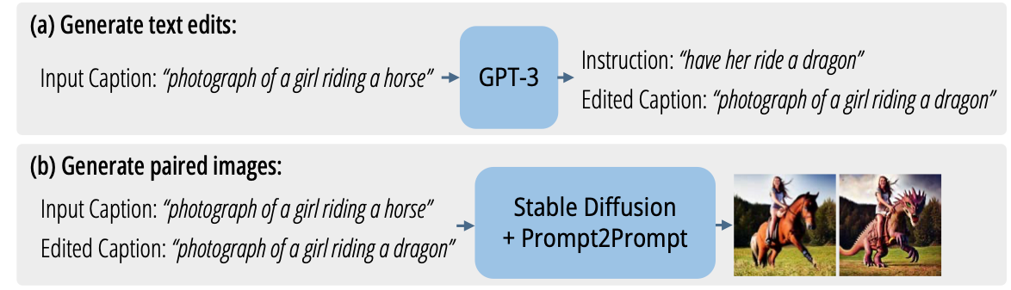


Motivation
DL-based, instruction-guided image editing needs large-scale, high-quality datasets.
Generating paired data: (original image, instruction, edited image).
Finetune LLMs to generate edited captions
(original caption, instruction, edited caption)
SD
original caption original image
edited caption edited image
(original image, edited image)
SD, P2P
Brooks et al., InstructPix2Pix: Learning to follow image editing instructions. CVPR, 2023.
Problem: instruction never sees and interacts with original image and edited image directly.
“make it a daydream”

Slide 5
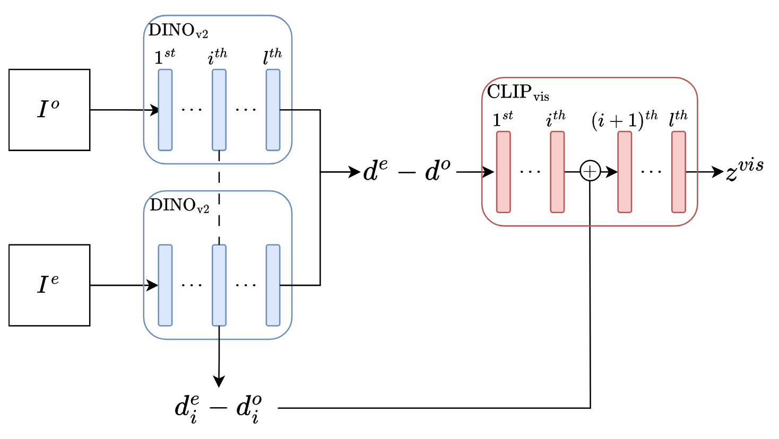
Instruction refinement
Refine instruction after seeing differences between original image and edited image.
original image
differences
encoded differences
edited image
I-CLIP_{vis}: visual difference encoder

Slide 6
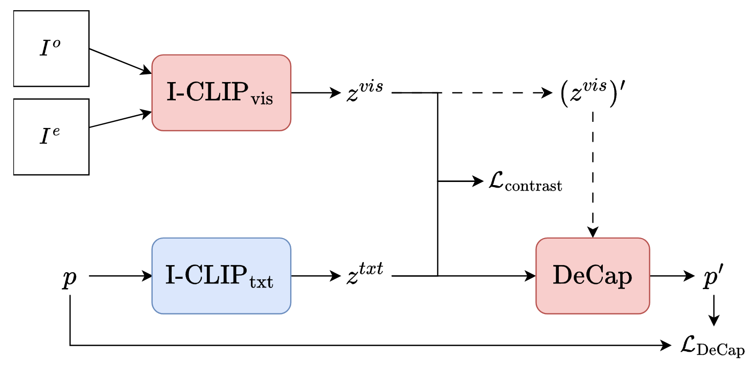
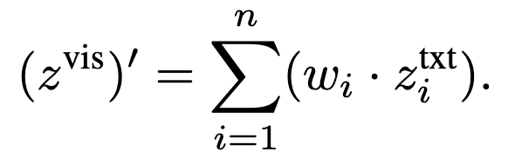
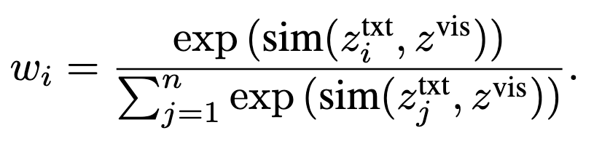

Instruction refinement
instruction should describe differences between original image and edited image.
encoded differences
original image
edited image
Dress $z^{vis}$ up as a text encoding during inference.
instruction
refined instruction
I-CLIP architecture
Inference: replace instruction with refined instruction if the latter is better.

Slide 7
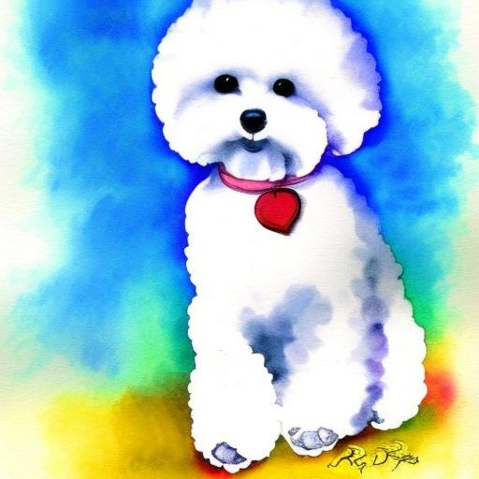
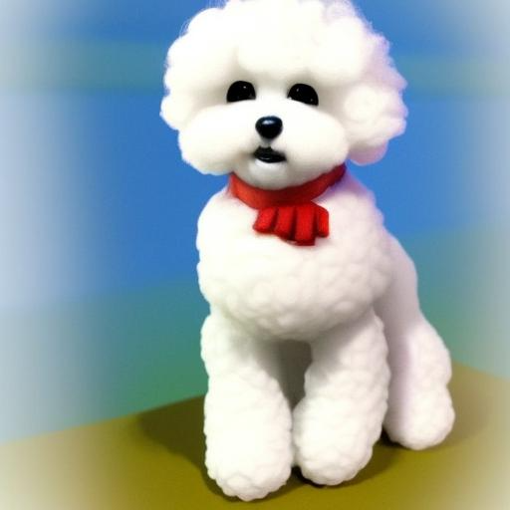


Instruction refinement
original image
edited image
instruction
refined instruction
Paper: “as a 3 d sculpture”
“make it a video game character”
Reproduced: “as a 3 d computer model”
Paper: “make it spring”
“make it a daydream”
Reproduced: “make it a summer day”

Slide 8
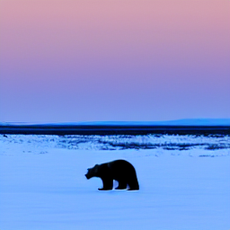
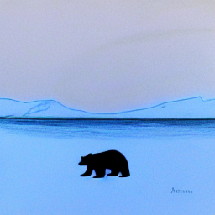
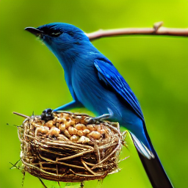
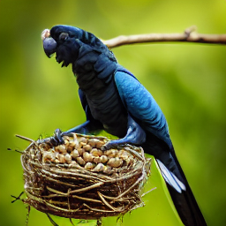
Instruction refinement
original image
edited image
instruction
refined instruction (reproduced)
“make it a drawing”
“make it into a watercolor painting”
“make the bird a cockatoo”
“replace the bird with a hummingbird”

Slide 9
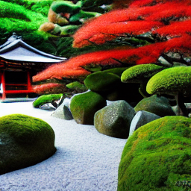
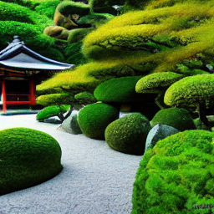
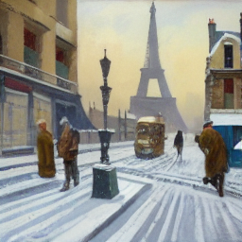
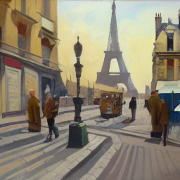
Instruction refinement
original image
edited image
instruction
refined instruction (reproduced)
“add a hedge maze”
“the leaves yellow leaves”
“make it a sunny day”
“make it a sunny day”

Slide 10
original image
edited image
original instruction
refined instruction
add a hedge maze
the leaves yellow leaves
make it a sunny day
make it a sunny day
make it a video game character
as a 3 d computer model
make it a daydream
make it a summer day
make it a drawing
make it into a watercolor painting
make the bird a cockatoo
replace the bird with a hummingbird

Slide 11
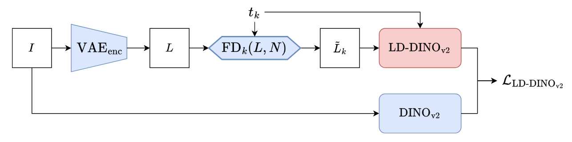

I-CLIP as a judge
$ℒ_{I−CLIP}=1−sim(z^{vis},z^{txt})$
is used when finetuning SD-based image editing models.
judges whether the differences between original images and
generated edited images match instruction.
However, SD works in latent space while DINO works on raw images.
Distillation: DINOv2 $→$ LD-DINOv2.
Replace DINOv2 in I-CLIP_{vis} with LD-DINOv2.
In this way, I-CLIP can extracting $z^{vis}$ from SD outputs (in latent space) with LD-DINOv2, without decoding SD outputs into generated images
replace

Slide 12
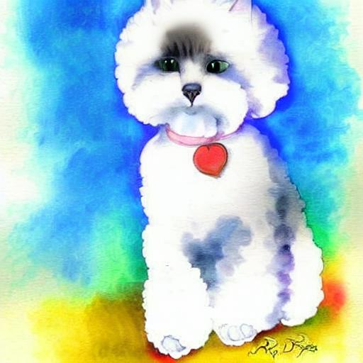
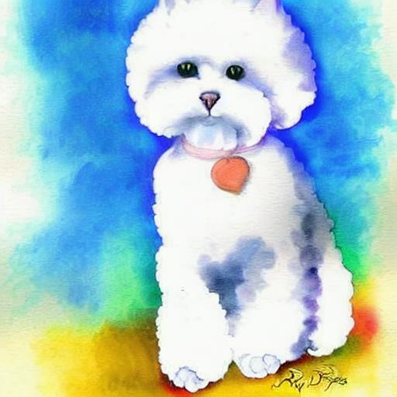
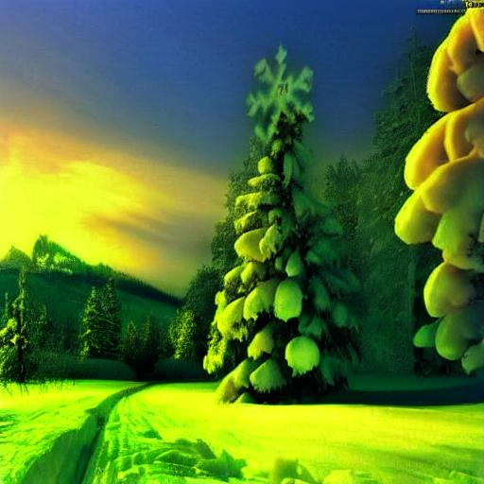
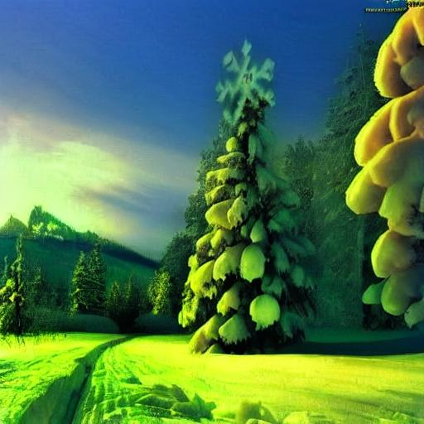
I-CLIP as a judge
edited image
original image
instruction
paper
reproduced
“make it a cat”
“remove snow”

Slide 13
Outline
Introduction
Motivation
Methods
Results
Improvements

Slide 14
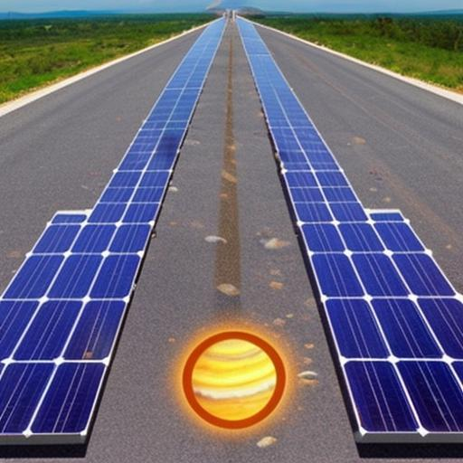

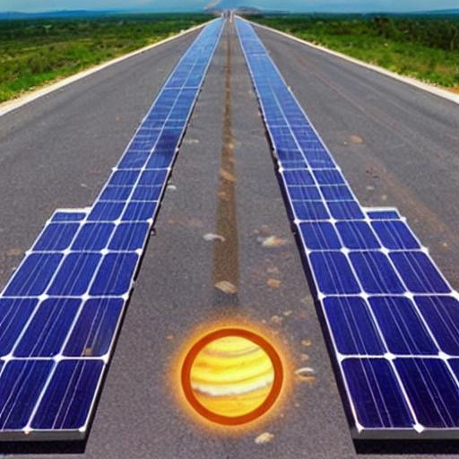
Key changes uncaught
Preview: https://huggingface.co/datasets/SherryXTChen/InstructCLIP-InstructPix2Pix-Data
In the refined dataset, there are still some examples where the refined instruction doesn’t match the image pair well:
original image
edited image
original instruction
refined instruction
“turn it into a shopping mall”
(?????)
“make it into a movie poster”
(??)
Actually, if we feed our editing model with the original image and the refined instruction above:
“make it into a movie poster”

Slide 15
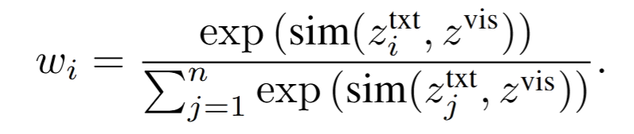
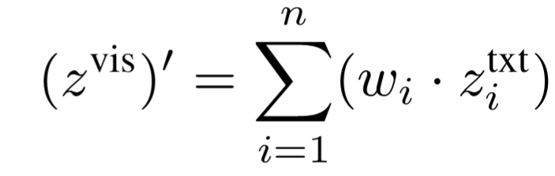
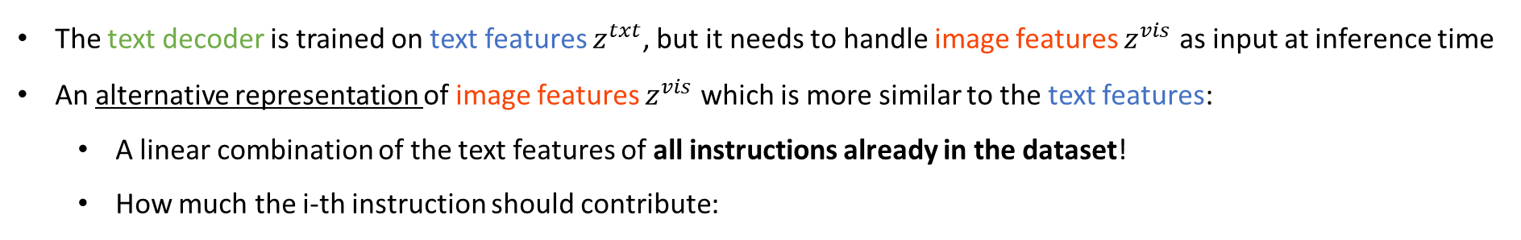
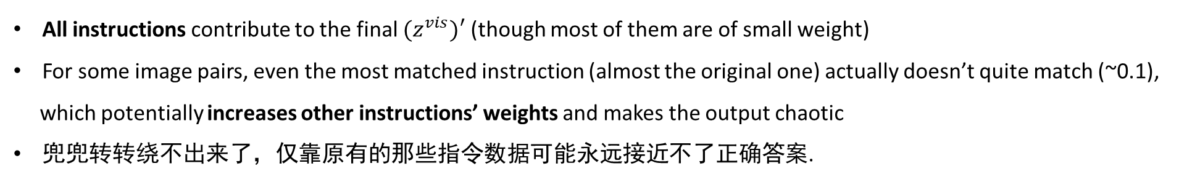
Instruction refinement mechanism
The text decoder is trained on text features $z^{txt}$, but it needs to handle image features $z^{vis}$ as input at inference time
An alternative representation of image features $z^{vis}$which is more similar to the text features:
A linear combination of the text features of all instructions already in the dataset!
How much the i-th instruction should contribute:
Text decoder
refined instruction
Possible problems:
All instructions contribute to the final ${(z}^{vis})′$ (though most of them are of small weight)
For some image pairs, even the most matched instruction (almost the original one) actually doesn’t quite match (~0.1),
which potentially increases other instructions’ weights and makes the output chaotic
兜兜转转绕不出来了，仅靠原有的那些指令数据可能永远接近不了正确答案.

Slide 16
A possible solution
Real-time instruction updating: With model being trained, replace some instructions in the dataset with refined instructions (calculated by the current model) every several training epochs
Experiment:
Training on the first 50000 samples from the dataset
Starting from the 60000th epoch, replace 15% instructions every 2000 epochs, until the 100000th epoch
original image
edited image
refined instruction
re-re-re-…-re-refined instruction
“make it into a movie poster”
(??)
“make it spread”
(?!)
However, only a few cases become better.

Slide 17

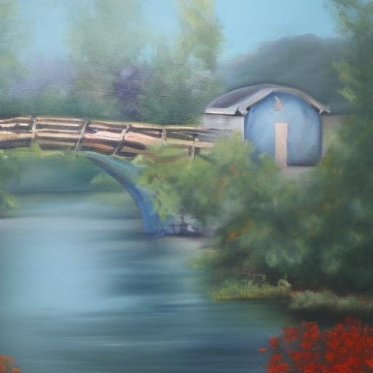
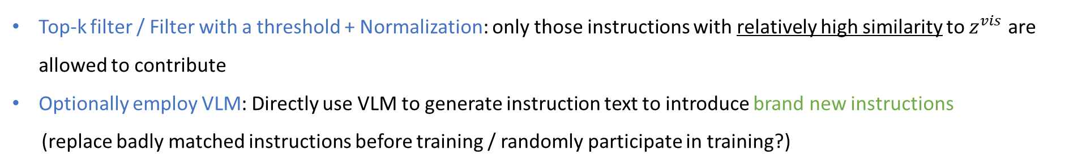
Other ideas (unvalidated)
Top-k filter / Filter with a threshold + Normalization: only those instructions with relatively high similarity to $z^{vis}$ are allowed to contribute
Optionally employ VLM: Directly use VLM to generate instruction text to introduce brand new instructions
(replace badly matched instructions before training / randomly participate in training?)
“Provide an edit instruction that transforms the source image to the target image”
→ “Enhance colors, add textures, soften edges…”
Better metrics than CLIP/DINO: make qualitative performance quantizable
VIEScore: Instruction Alignment, Edit Faithfulness, …

Slide 18
Reference
Chen et al., Instruct-CLIP: improving instruction-guided image editing with automated data refinement using contrastive learning. CVPR, 2025.
Brooks et al., InstructPix2Pix: learning to follow image editing instructions. CVPR, 2023.

Slide 19

Thank you!

